Slide 1
PHOTOVOICE AS A TOOL FOR SOCIAL CHANGE:
An Introduction and guide through the Methods of Photovoice
Presented by: Anthony Webb and Olivia Andringa

Slide 2
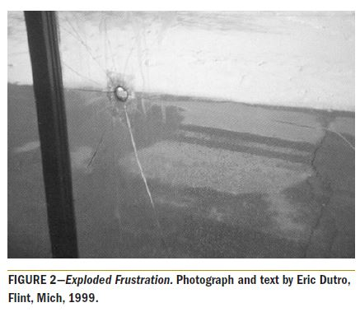
(Wang, Morrel-Samuels, Hutchison, Bell, & Pestronk, 2004)

Slide 3
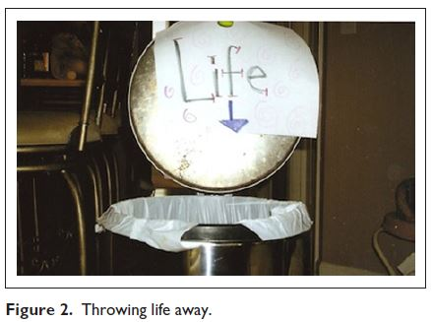
(Woods-Jaeger, Sparks, Turner, Griffith, Jackson & Lightfoot, 2013)

Slide 4
ACTIVTY
Share an issue that you would like to see change
Example: parking on campus, policies at UWT, etc.

Slide 5
PHOTOVOICE METHODOLOGY
Participatory action research method
Participants use photographs and captions to address issues in their community
It is a method designed for use by community members
Provides a platform for people’s concerns to be heard

Slide 6
PURPOSE
> Helping community members with recognizing their own power to enact change within their community
> Balancing research with action

Slide 7
KEY CONCEPTS (Suffla & Bawa, 2012)
Images teach
Pictures can influence policy
Community members should participate in shaping policy
Influential policymakers must be audience to perspectives of community members
Individual and community actions are emphasized

Slide 8
HOW TO: PHOTOVOICE
> Participants individually take photos of issues they want addressed
> As a community, select photos that best represent their experiences
> With guided facilitation, engage in critical analysis about the meaning of each photo
> Then identify actions that can be taken to develop, enhance, and empower their community

Slide 9
GOALS OF PHOTOVOICE
Record and reflect on the community’s strengths and concerns
Promote conversation and knowledge about issues
To reach policymakers

Slide 10
EXAMPLE
BARRIERS TO STUDENT ACCESS AND SUCCESS

Slide 11
References
Wang, C. C., Morrel-Samuels, S., Hutchison, P. M., Bell, L., Pestronk, R. M. (2004). Flint photovoice: Community building among youths, adults, and policymakers. American Journal of Public Health, 94, 911-913.
Woods-Jaeger, B. A., Sparks, A., Turner, K., Griffith, T., Jackson, M., Lightfoot, A. F. (2013). Exploring the social and community context of African American adolescents’ HIV vulnerability. Qualitative Health Research, 23, 1541-1550. doi: 10.1177/1049732313507143

Slide 12
THANK YOU.
Questions? Comments?

